Slide 1
Solo Project: Destiny Item Manager
Jacob Eddison

Slide 2
Project Brief
Solo Project
CRUD Functionality
Testing
Version Control

Slide 3
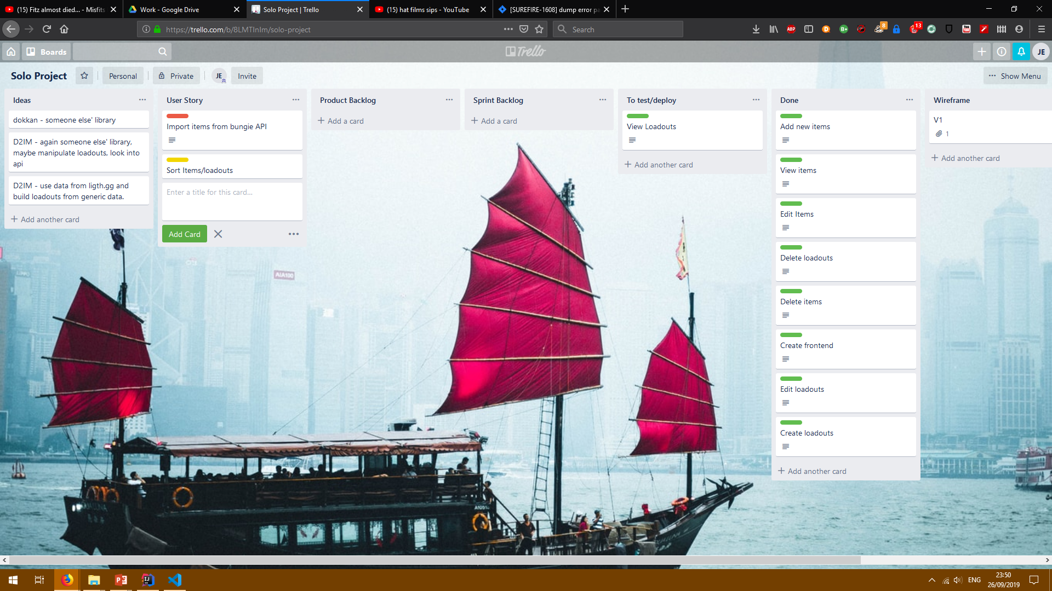
Trello Board

Slide 4
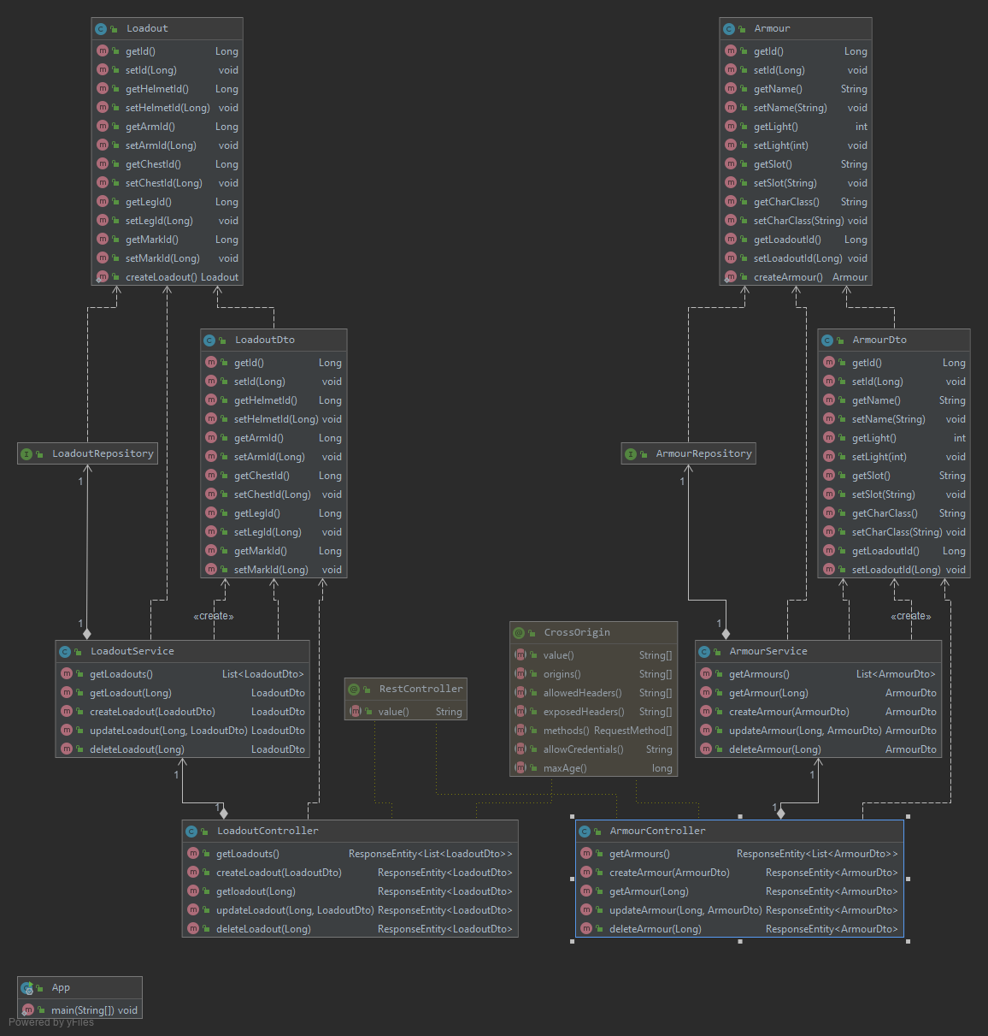
API Diagram

Slide 5
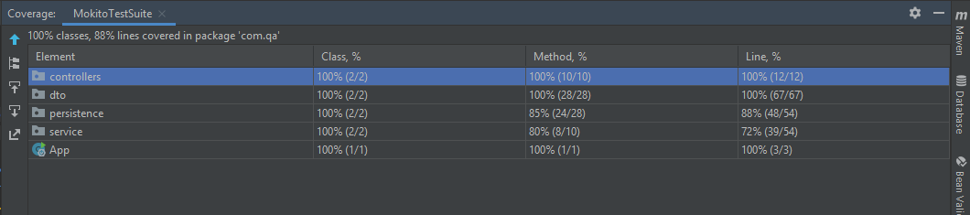
Unit Testing

Slide 6
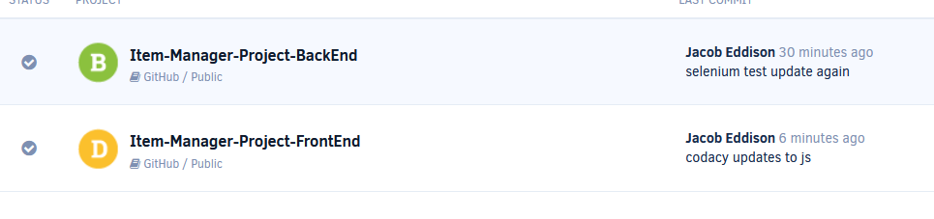
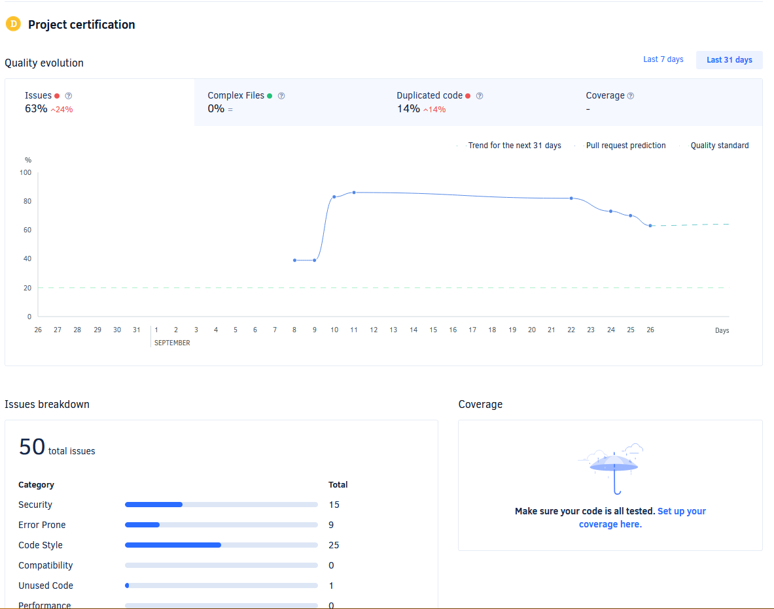
Codacy Testing

Slide 7
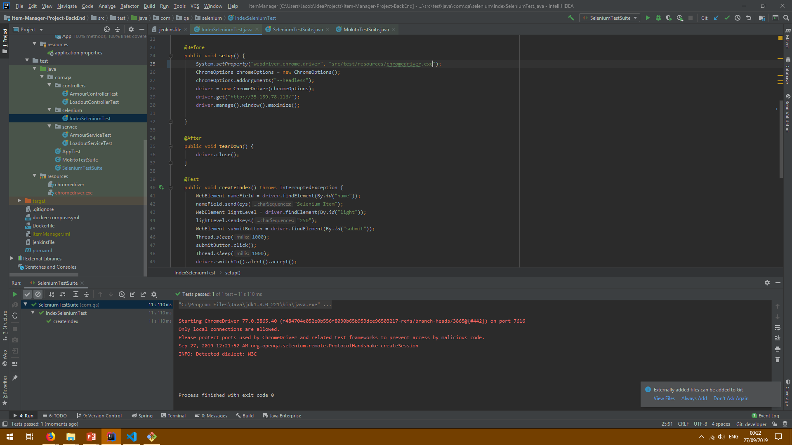
Selenium Testing

Slide 8
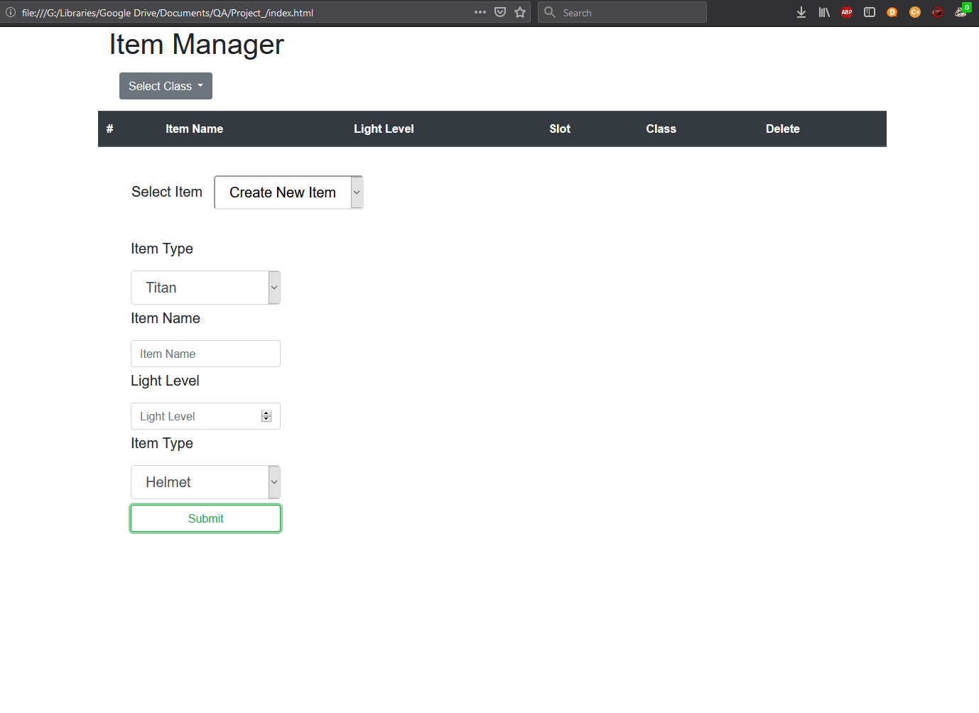
Front End

Slide 9
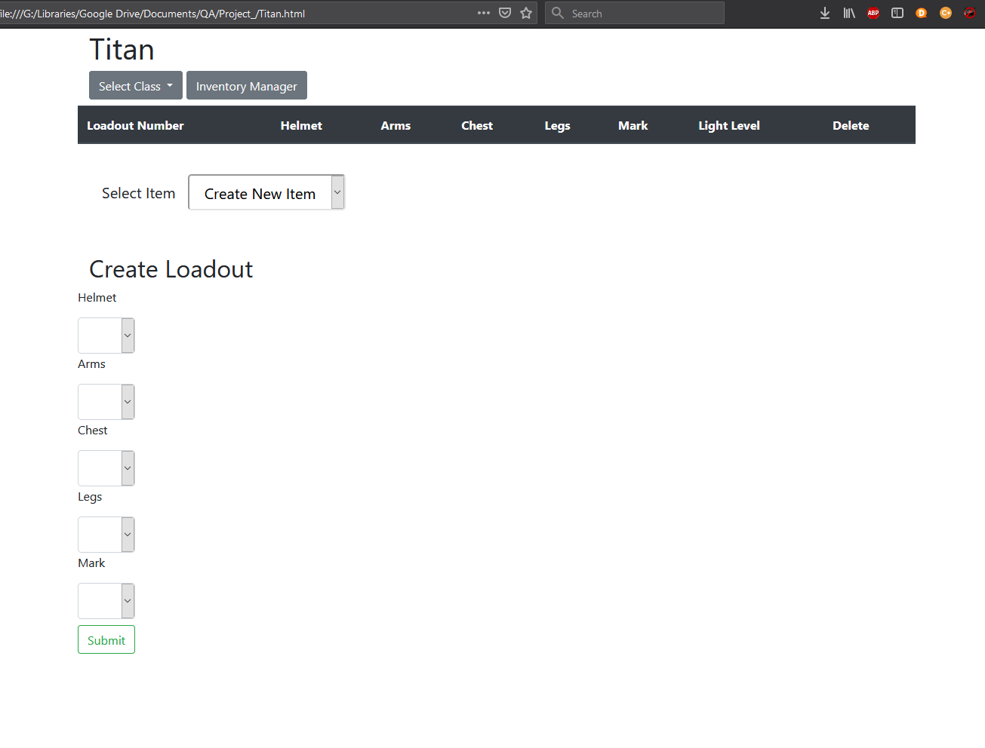
Front End

Slide 10
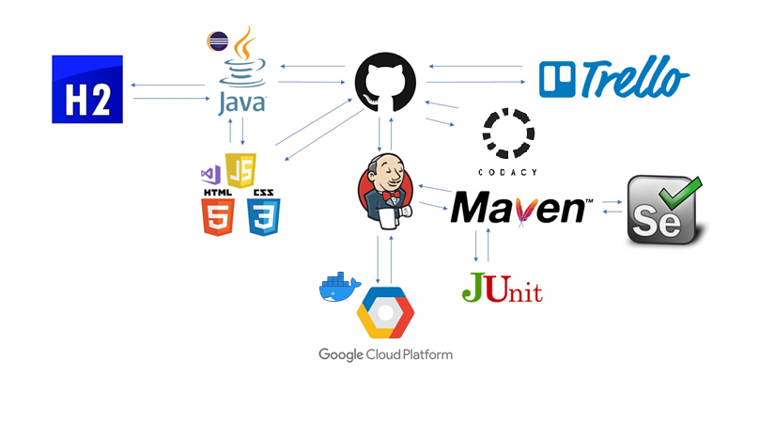




CI Pipeline

Slide 11
Summary
Testing – Junit, Mokito, Selenium and Codacy.
CI Pipeline – Jenkins, GitHub, GCP.
FrontEnd – HTML, CSS, JavaScript.
BackEnd – Java, Springboot, Maven.

Slide 12
Future Improvements
Add images to display items.
Separate items and loadouts by class.
Integrate with Bungie API.

Slide 13
Demo
http://35.189.78.116

Slide 14
Questions?
Thanks for listening

